Slide 1
CodeT5: Identifier-aware Unified Pre-trained Encoder-Decoder Models
for Code Understanding and Generation（EMNLP2021）
2021.10.31
Reported by Xiaoke Li

Slide 2
CodeT5
Notes:
关于codet5代码理解代码生成任务图解

Slide 3
Encoding NL and PL
INPUT
NL-PL
x = ([CLS], w1, ..., wn, [SEP], c1, ..., cm, [SEP])
PL-ONLY
x = ([CLS], c1, ..., cm, [SEP])
We focus on the type of identifiers (e.g., function names and variables)
as they are one of the most PL-agnostic features and reserve rich code
semantics.
where each represents whether the code token ci is an identifier or not.

Slide 4
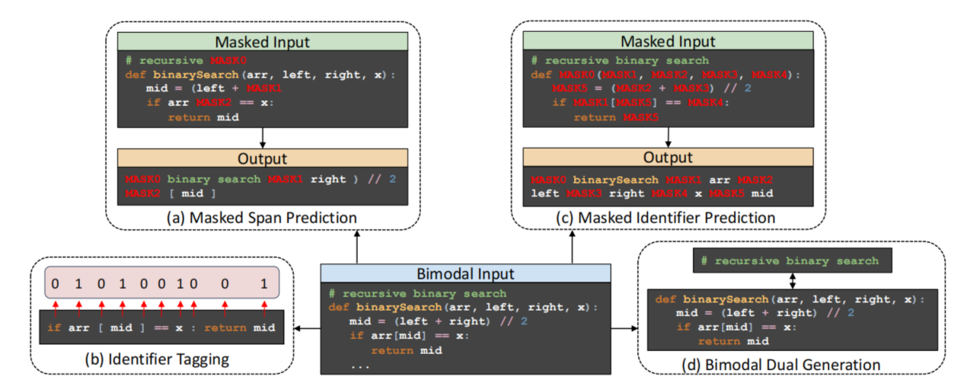
pre-training task

Slide 5
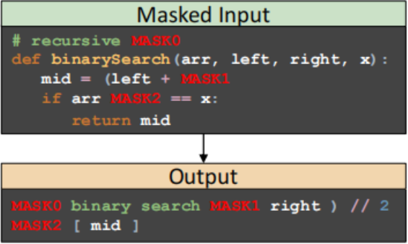
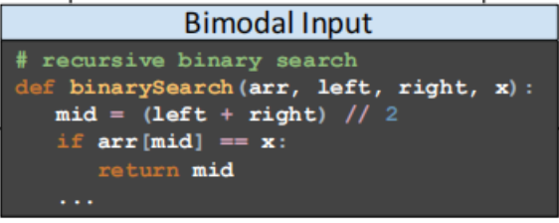
pre-training task
Masked Span Prediction (MSP)

Slide 6
pre-training task
Identififier Tagging (IT)

Slide 7
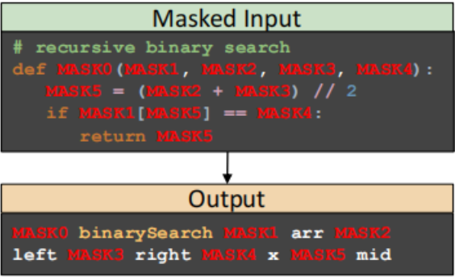
pre-training task
Masked Identififier Prediction (MIP)

Slide 8
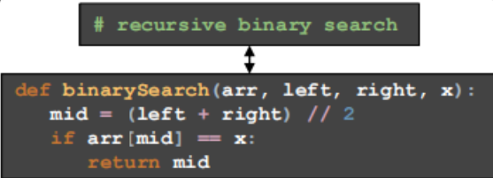
pre-training task
Bimodal Dual Generation

Slide 9
Fine-tuning
Generation task(generate and translate)
1.Seq2Seq
Understanding task(summarize,defect ande refine)
1.generating the label as a unigram target sequence.
2.predicting it from the vocabulary of class labels based on the last decoder hidden state.
Multi-task Learning

Slide 10
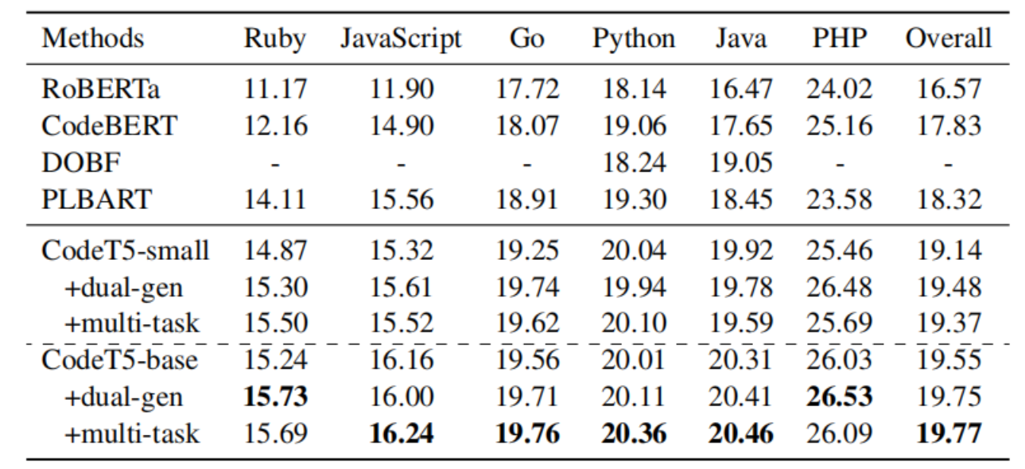
Experiments
Code Summarization

Slide 11
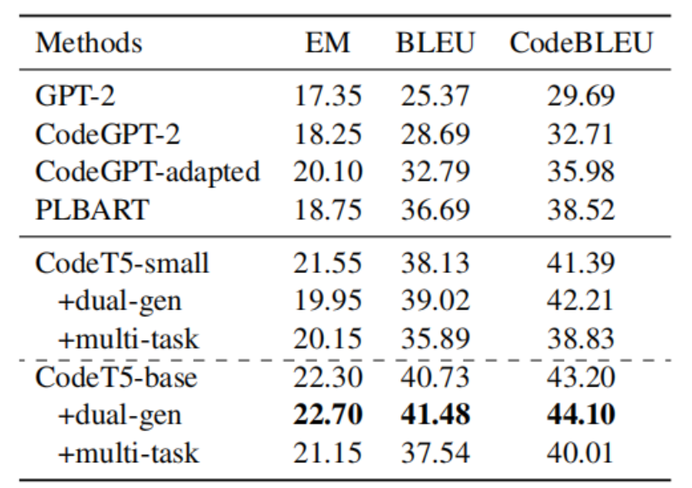
Experiment
Code generation

Slide 12
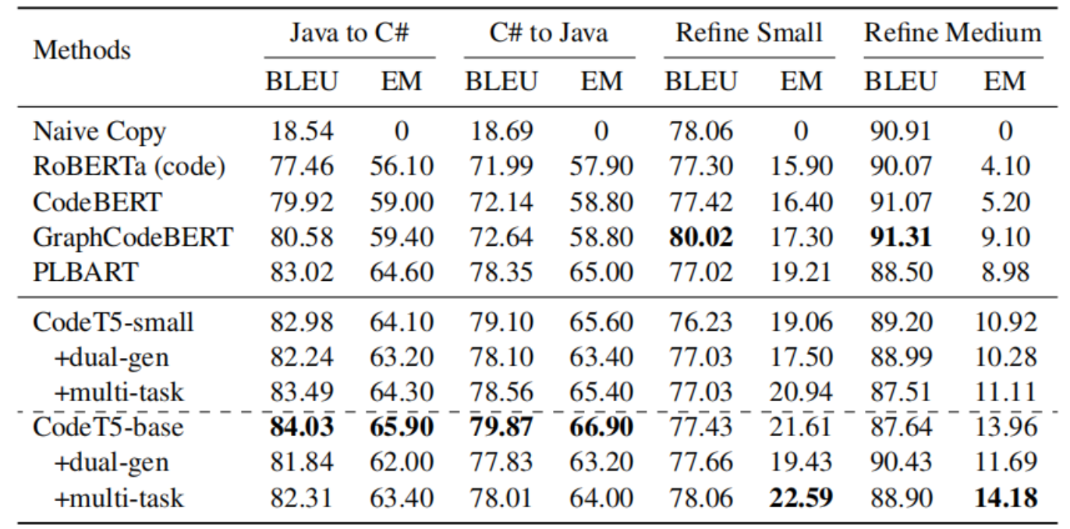
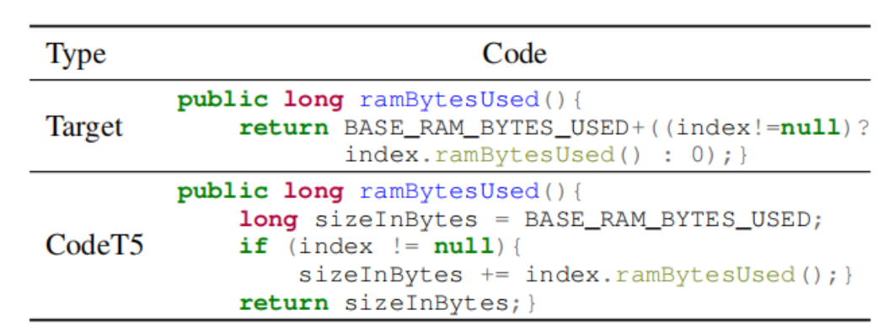
Experiment
Code translation and refinement

Slide 13
result

Slide 14
Thanks

